Slide 1


Hotel Aggregator
Project – 3
Internship With Mentorness

Slide 2
MY HEARTFELT THANKS TO
MENTORNESS
FOR GIVING ME INTERNSHIP
AND
SUPPORTING ME.

Slide 3
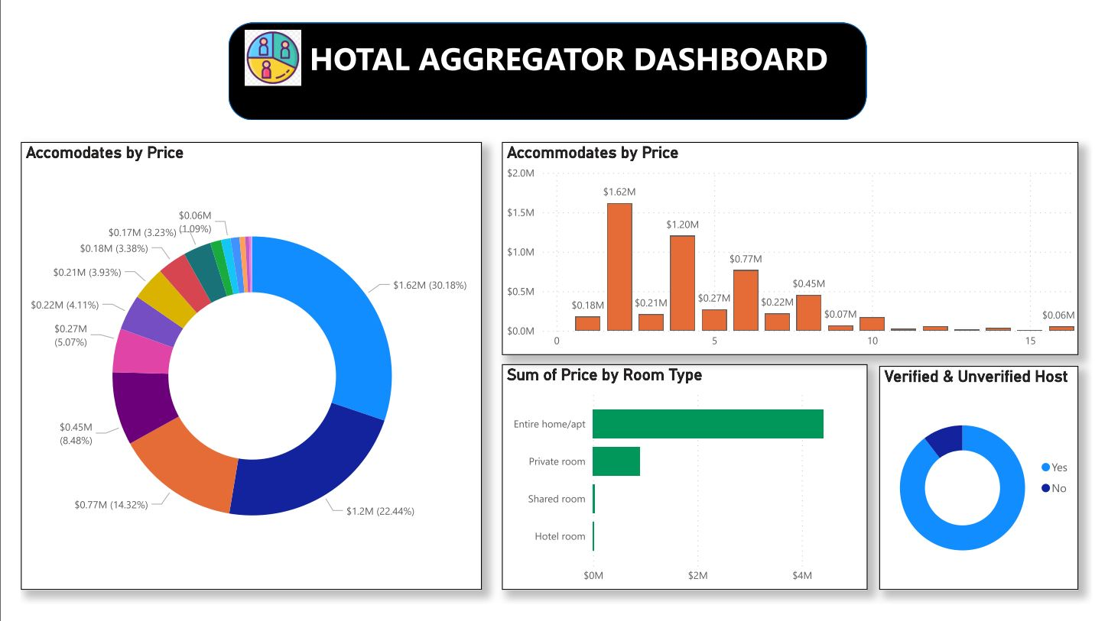

Slide 4
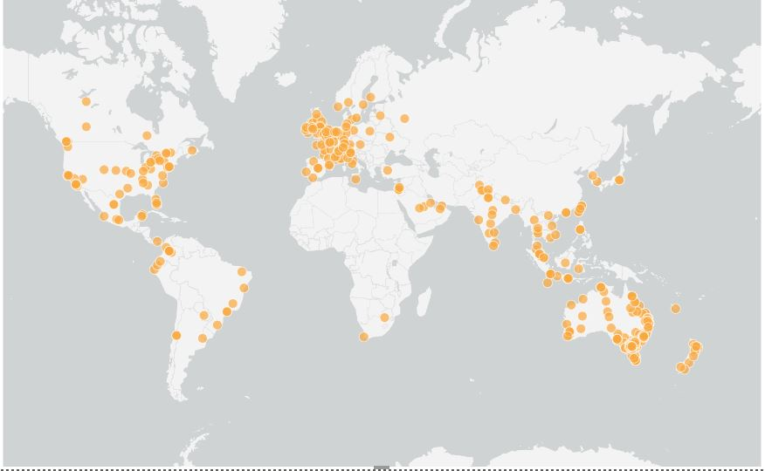

Slide 5
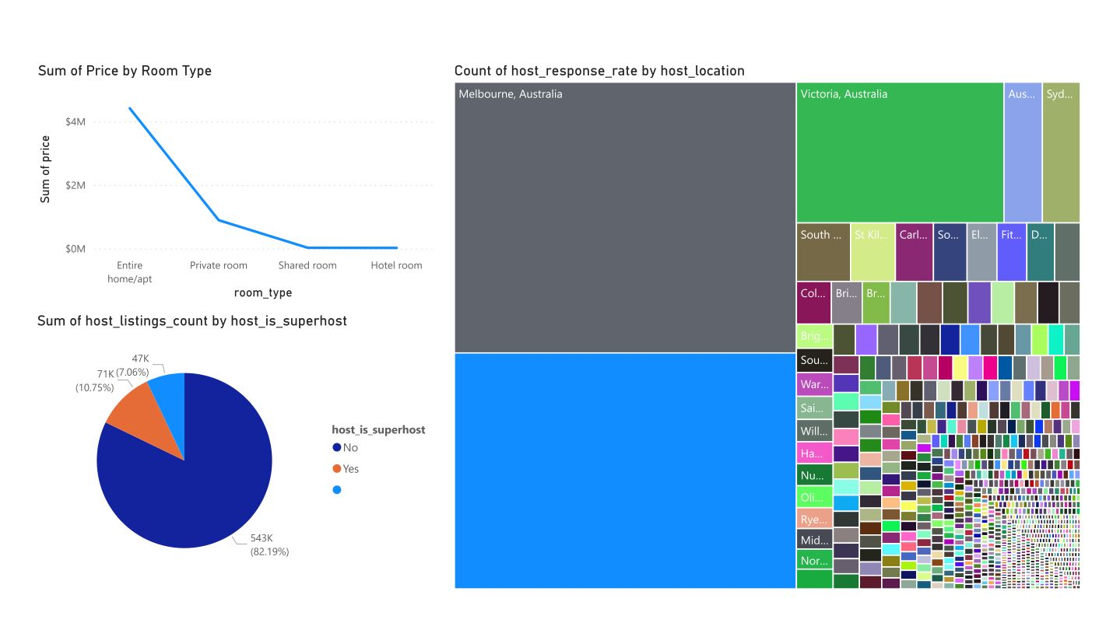

Slide 6
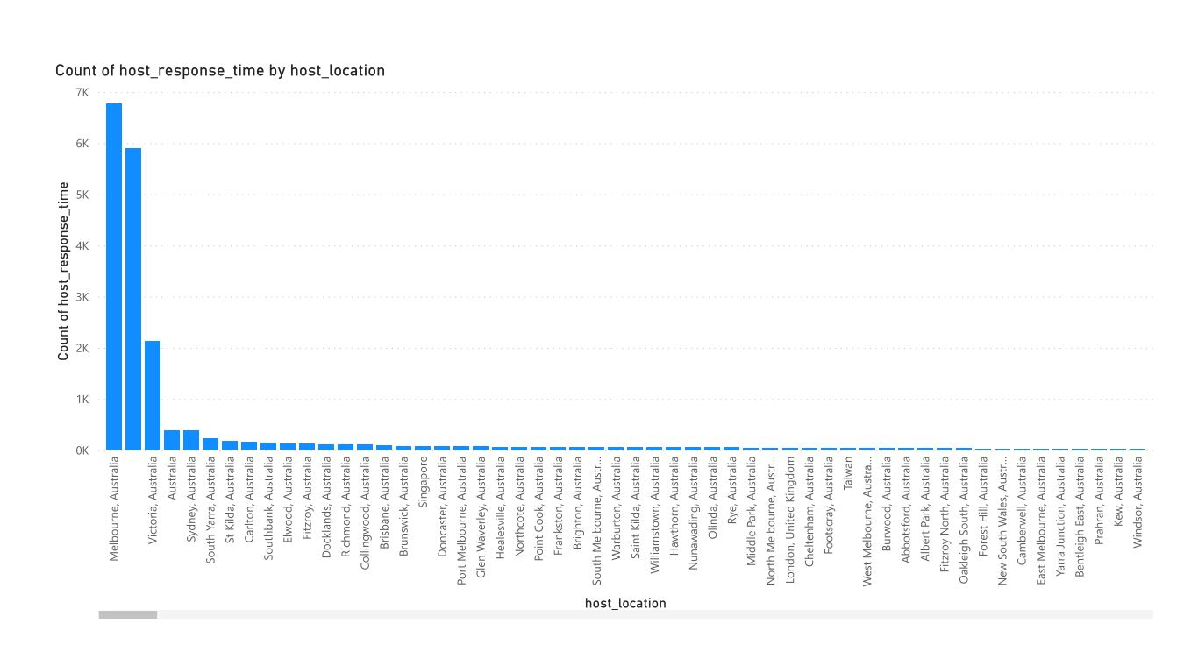

Slide 7
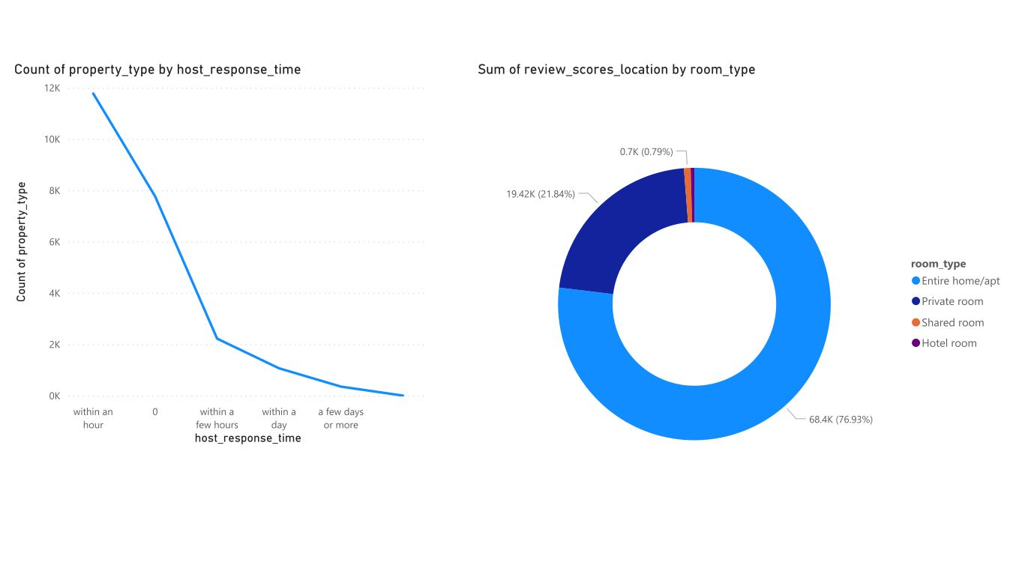

Slide 8
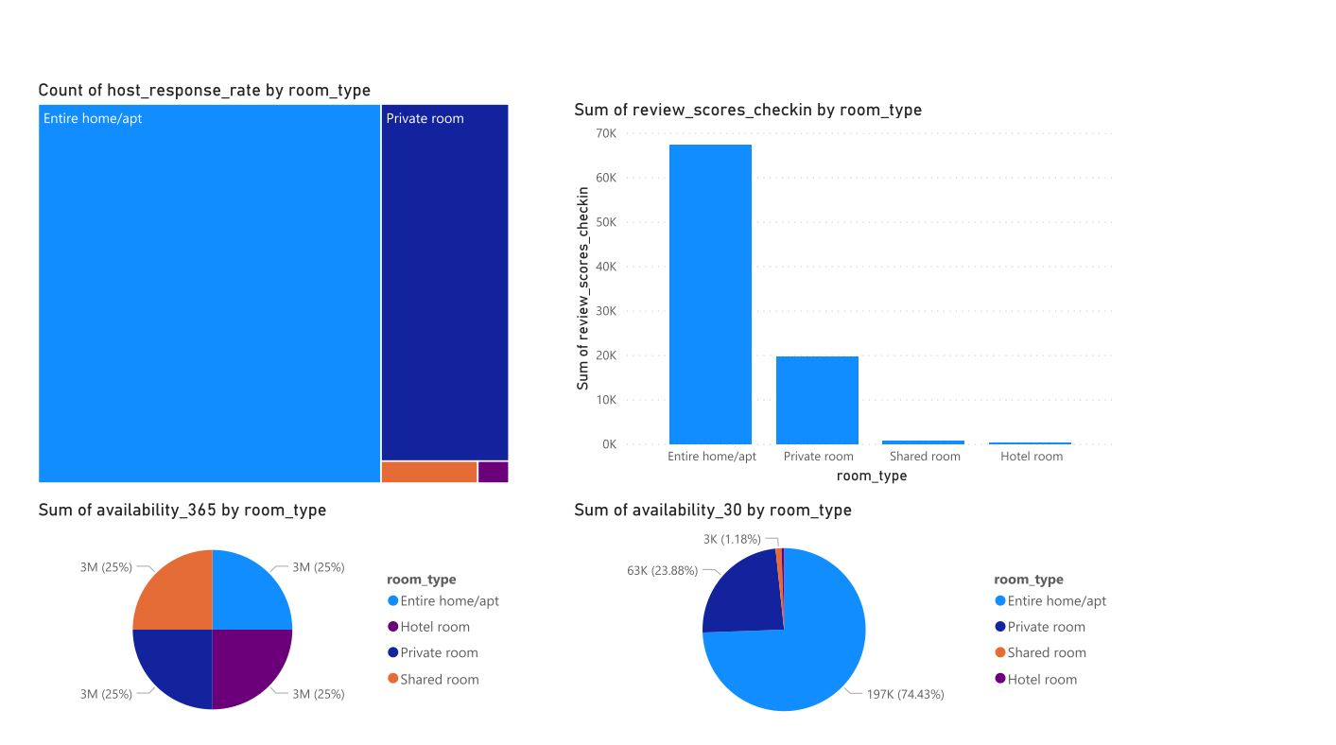

Slide 9
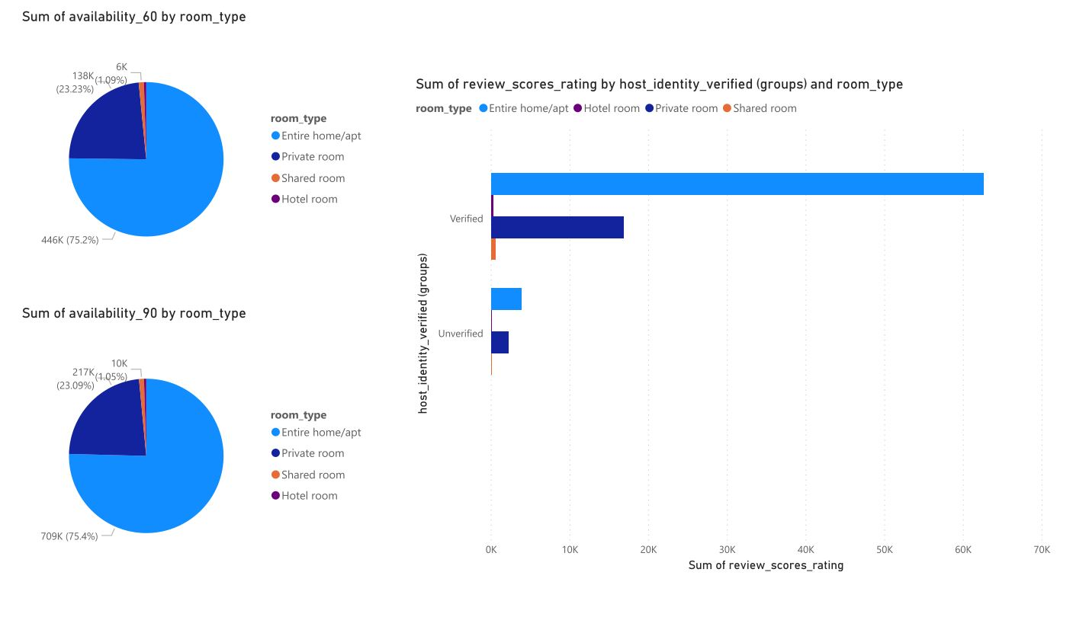

Slide 10
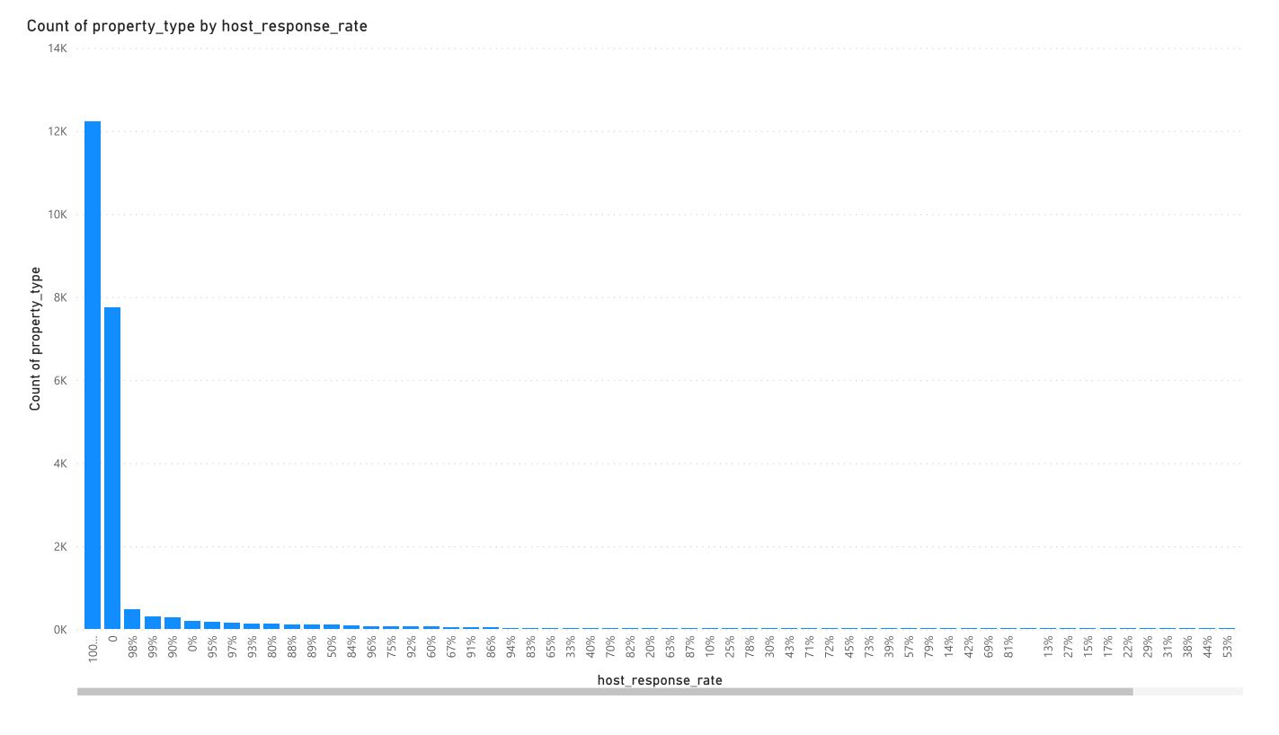

Slide 11
THANKYOU FOR WATCHING.
I HOPE YOU LEARN FROM THIS PRESENTATION.
IF YOU HAVE ANY QUERY, COMMENT OR CONTACT ME.

